Slide 1

“Optimize the power consumption
of Zone 1 based on various environmental and
meteorological factors in
Wellington, New-Zealand “

Slide 2


Introduction and Domain Overview
As the world faces increasing energy demands, optimizing power consumption has become essential, particularly in urban areas like Wellington, New Zealand.
This project aims to develop a machine learning-based model that can accurately predict power consumption in Zone 1 of Wellington, informed by a variety of environmental and meteorological factors.
The model seeks to provide valuable insights for energy providers and policymakers, enabling them to manage resources efficiently and enhance power consumption strategies.
Power consumption in any area can be influenced by numerous variables, including temperature, humidity, wind speed, solar radiation, air quality, and cloud cover. An accurate predictive model will empower stakeholders to optimize energy usage, reduce costs, and contribute to sustainability efforts.

Slide 3


Problem Statement and Overview (Observation)
The primary challenge is to develop an accurate model for predicting power consumption in Zone 1 of Wellington.
The objective is to create a machine learning solution that evaluates various environmental and meteorological influences on power consumption, offering actionable insights for energy managers (to enhance resource allocation) and residents (to understand energy usage patterns).
Project Aim: To build a robust machine learning model for predicting Zone 1 power consumption.
Energy Provider Challenges: Efficiently managing energy resources while adapting to fluctuating demand patterns in a dynamic environment.
=

Slide 4


Dataset Structure Dataset Structure
The dataset utilized for predicting power consumption comprises 9 features and 52,584 records.
These features encompass critical environmental parameters such as temperature, humidity, wind speed, solar radiation measurements, air quality index, cloud cover, and the target variable of power consumption.
Number of Columns: 9
Number of Rows: 52,584

Slide 5


Insights Gained:
In this analysis and model building, key insights:
Temperature Influence: Power consumption exhibits a direct correlation with temperature variations; higher temperatures typically lead to increased energy usage, particularly for cooling systems.
Humidity Impact: Elevated humidity levels can further exacerbate power consumption, particularly in air conditioning systems, as they require more energy to maintain comfortable indoor conditions.
Wind Speed and Energy Demand: Wind speed influences energy requirements for heating and cooling; higher wind speeds can affect perceived temperature and, subsequently, power usage.
Solar Radiation and Consumption: Increased diffuse solar radiation correlates with reduced power consumption during daylight hours, showcasing the potential for solar energy utilization.

Slide 6
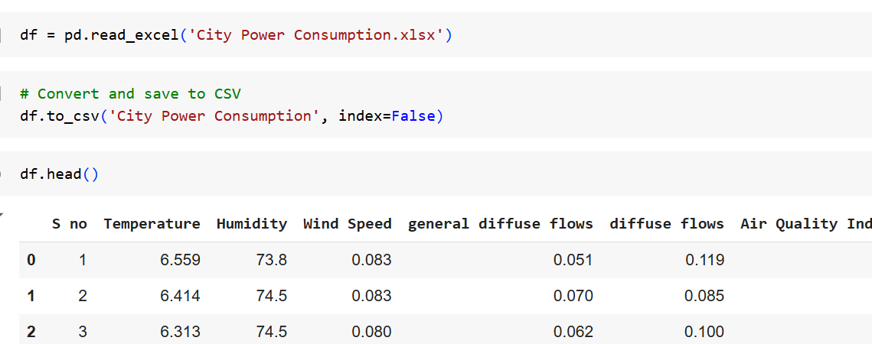

Data Exploration
Data Import and Conversion
Dataset: Loaded data from an Excel file named PowerData.xlsx.
Format Conversion: Converted the DataFrame to CSV format (PowerData.csv) for enhanced compatibility and ease of analysis.
Unique Values Count: Displayed the number of unique values for each column.

Slide 7

Data Preprocessing
1. Handling Missing Values:
Missing Values Summary:Temperature: 320, Humidity: 25, Wind Speed: 71, General Diffuse Flows: 308, Diffuse Flows: 15, Air Quality Index (PM): 18
Imputation Strategy:Filled with mean (Temperature, Wind Speed, General Diffuse Flows, Air Quality Index) and median (Humidity).
2. Duplicate Values:
Total Duplicates: 0 (No action required).
3. Data Type Conversion:
Converted Temperature, Humidity, Wind Speed to float; Cloudiness to integer.
4. Outlier Detection:
Method: Z-score
Initial Threshold: Removed rows with Z-scores > 3
Recommendation: Consider lowering threshold to 2.5 or 2 for enhanced detection.
5. Importance:
Effective preprocessing improves data quality and enhances modeling outcomes.

Slide 8
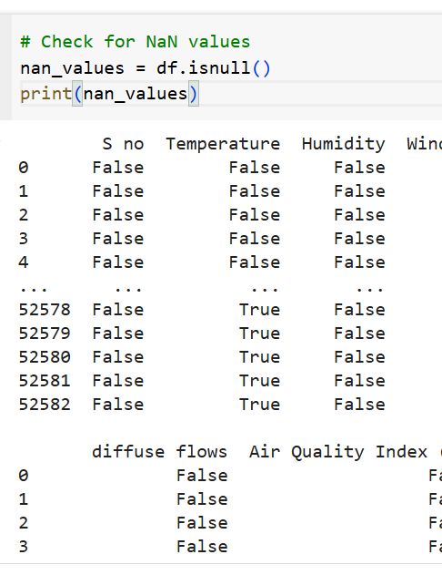
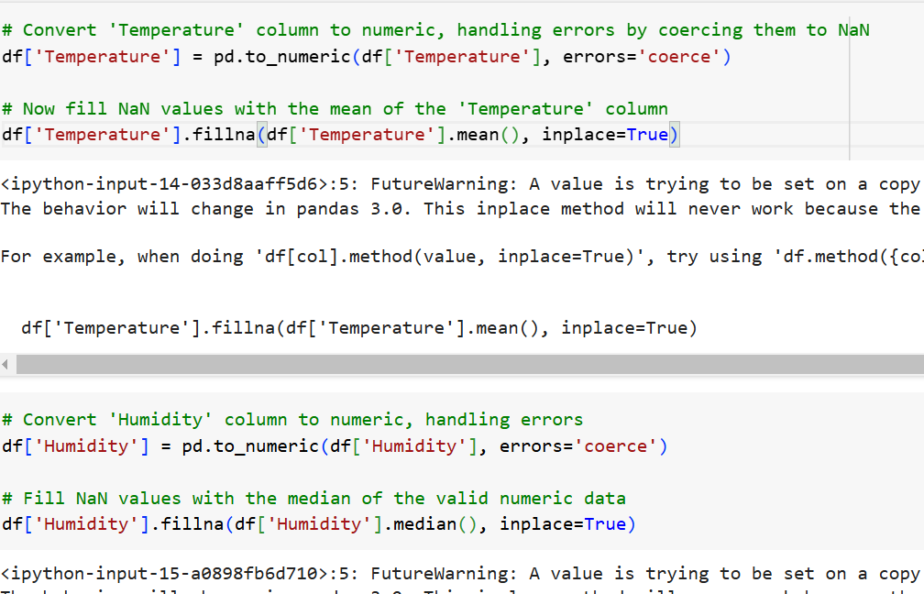


Data Preprocessing Visual representation (samples)

Slide 9

EDA and Data Visualization
1. Distribution of Categorical Features:
Objective: Visualize the frequency of each category.
Method: Count plots were created for each categorical column to identify prevalent categories and any potential imbalances.
2. Box Plots for Numerical Features:
Objective: Assess the spread and detect outliers in numerical data.
Method: Box plots were generated for numerical columns to visualize central tendency and identify any outliers.
Insights Gained
Visualizations provide valuable insights into data distribution and quality, guiding further analysis and preprocessing steps.

Slide 10
Feature Engineering
1. Interaction Features:
Created interaction terms to capture relationships between variables that may impact the model:
Temperature x Humidity: Multiplied Temperature and Humidity to capture joint effects.
Wind Speed x Temperature: Captured interaction between Wind Speed and Temperature.
2. Logarithmic Transformation:
Applied logarithmic transformation to handle skewness in highly variable features:
Transformed Air Quality Index (PM) and General Diffuse Flows for normalization.
3. Binning & Polynomial Features:
Binning: Grouped continuous variables into categories to simplify analysis:
Temperature (Low, Medium, High) and Wind Speed (Low, Medium, High, Very High).
Polynomial Features: Added squared terms for Temperature, Humidity, and Wind Speed to capture non-linear effects.
4. Scaling & Encoding:
Standardization: Scaled continuous features for consistent magnitude.
One-Hot Encoding: Categorical features encoded to prepare for modeling.

Slide 11
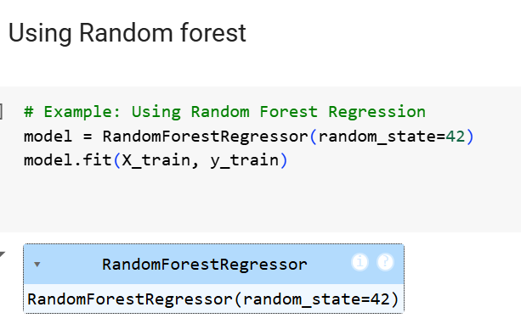
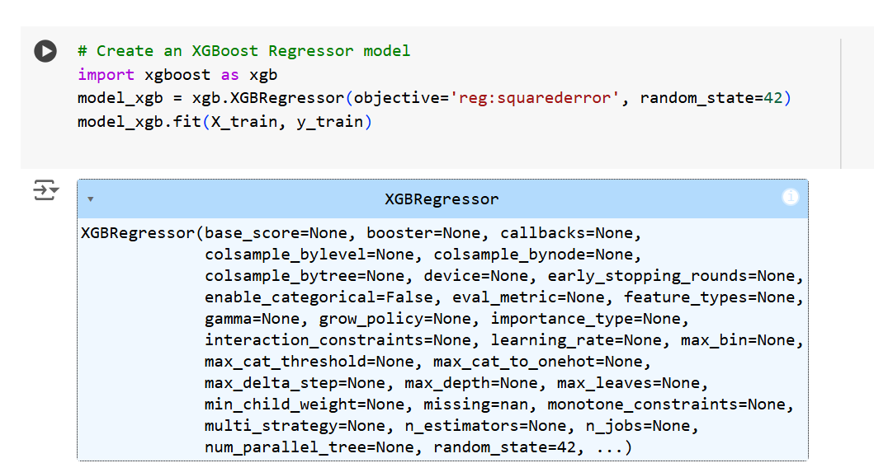
Model Selection and Evaluation
1. Models Trained:
Random Forest Regressor: Selected for its robustness and ability to capture complex feature interactions.
XGBoost Regressor: Chosen for its efficiency with larger datasets and strength in handling regression tasks.

Slide 12
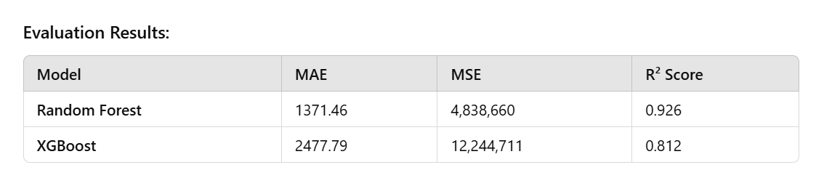

Random Forest Regressor outperformed XGBoost with a lower MAE, MSE, and a higher R² score, making it the preferred model for this problem.
Random Forest provides better predictive accuracy and should be used for further analysis and deployment.

Slide 13
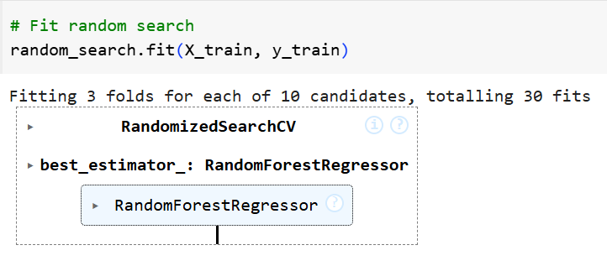
Model Optimization with RandomizedSearchCV
Optimize the Random Forest Regressor by tuning hyperparameters to improve prediction performance.
Parameter Tuning:
n_estimators: [100, 200]
max_depth: [3, 5, 7]
max_features: ['sqrt', 'log2', None]
min_samples_split: [2, 5, 10]
min_samples_leaf: [1, 2, 4]
Best Parameters: [Add best parameters here, e.g., n_estimators, max_depth, etc.]
Model Performance with Optimized Parameters
Mean Absolute Error (MAE): 3916.26
Mean Squared Error (MSE): 26,334,193.10
R² Score: 0.595

Slide 14

Results and Conclusion
Model Comparison
Random Forest Regressor (Untuned) performed best with:
MAE: 1371.46
MSE: 4,838,660.22
R² Score: 0.926
XGBoost and Tuned Random Forest showed lower performance, with lower R² scores and higher errors.

Slide 15

Random Forest (Untuned) is the optimal choice for this task, providing the best balance of accuracy and predictive power.
Further tuning of Random Forest or exploration of alternative models may yield even better results but, as it stands, the untuned model is reliable and ready for deployment.
Result: The untuned Random Forest model offers the most reliable performance for predicting power consumption based on meteorological factors in Wellington, New Zealand.
Future Direction: Additional tuning or ensemble methods could further enhance prediction accuracy for informed power management decisions in Zone 1..

Slide 16

Thank You :)

